Slide 1

Experiment 5: Real-Time Clock
Navarro, Rod Geryk C.
CPE161P-4– C1

Slide 2
OBJECTIVES
1. To demonstrate how a real-time clock works (hours-minutes-seconds).
2. To be able apply what you have learned in logic circuits and switching theory, microprocessors, and CPE160P.
3. To be able to apply real-time embedded system using arduino kit.

Slide 3
DISCUSSION
This Arduino-based digital clock displays hours and minutes on a 4-digit 7-segment display and seconds on a 16x2 I2C LCD. It tracks time using millis(), updating seconds every second and minutes every 60 seconds. Hours follow a 12-hour format.
The 7-segment display uses multiplexing for efficient digit control, while the LCD updates seconds in real-time. Functions handle time increments and display updates.
Possible Improvements: Adding buttons for manual time adjustment, an AM/PM indicator, and EEPROM storage for power-loss retention.

Slide 4
MATERIALS
Arduino Uno
4-digit Seven Segment Display
Liquid Crystal Display (LCD)
4 pcs 1k Resistors
Laptop

Slide 5
PROCEDURE
Create a working real-time clock using Arduino.
To demonstrate the usage of 4-digit seven segment display, and LCD.
Debug the code.

Slide 6
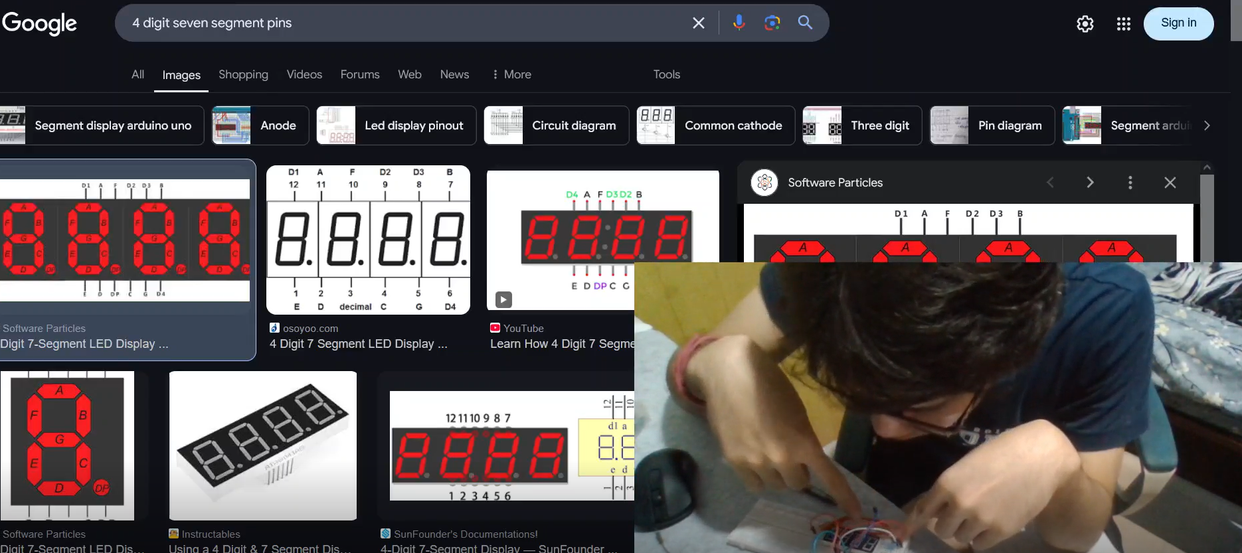
PROCEDURE

Slide 7
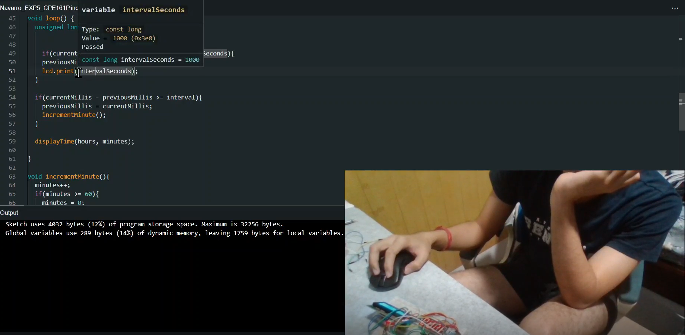
PROCEDURE

Slide 8
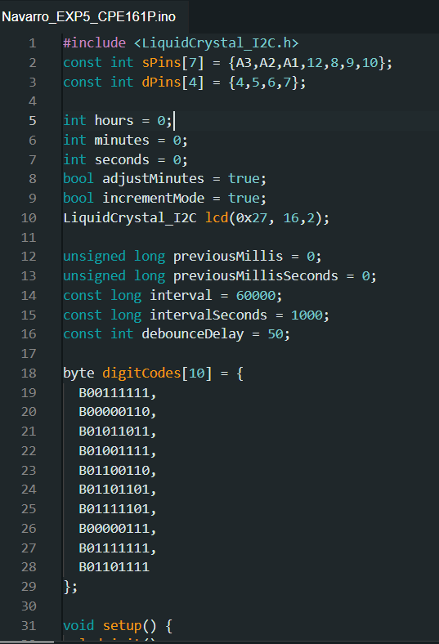
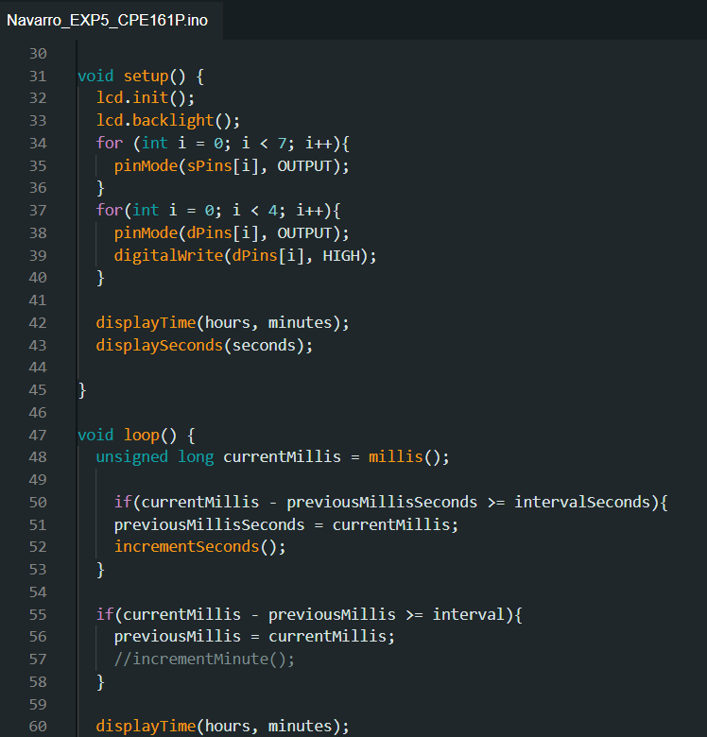
CODE

Slide 9
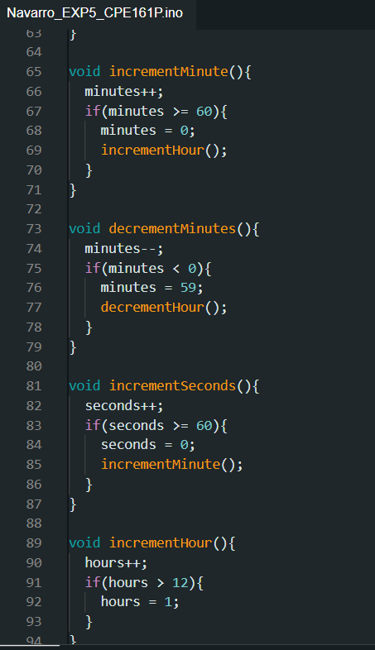
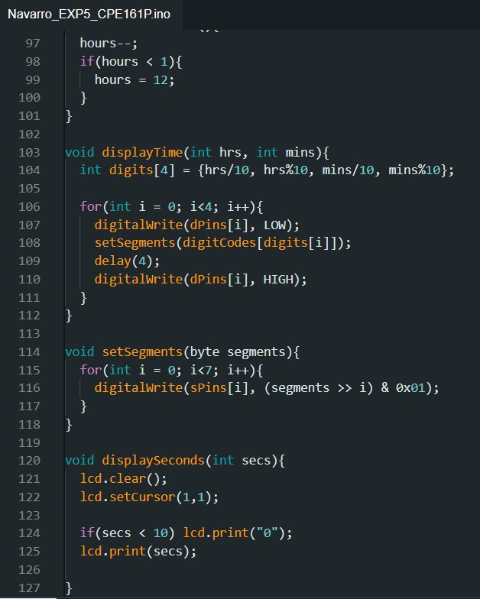
CODE

Slide 10
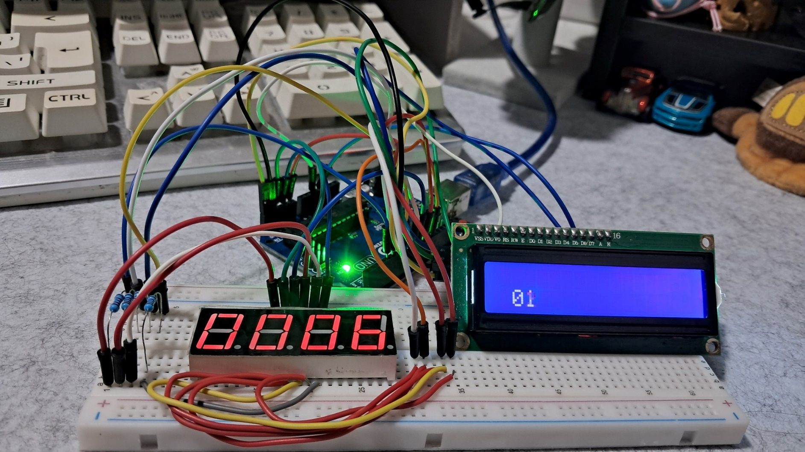
Final Output

Slide 11
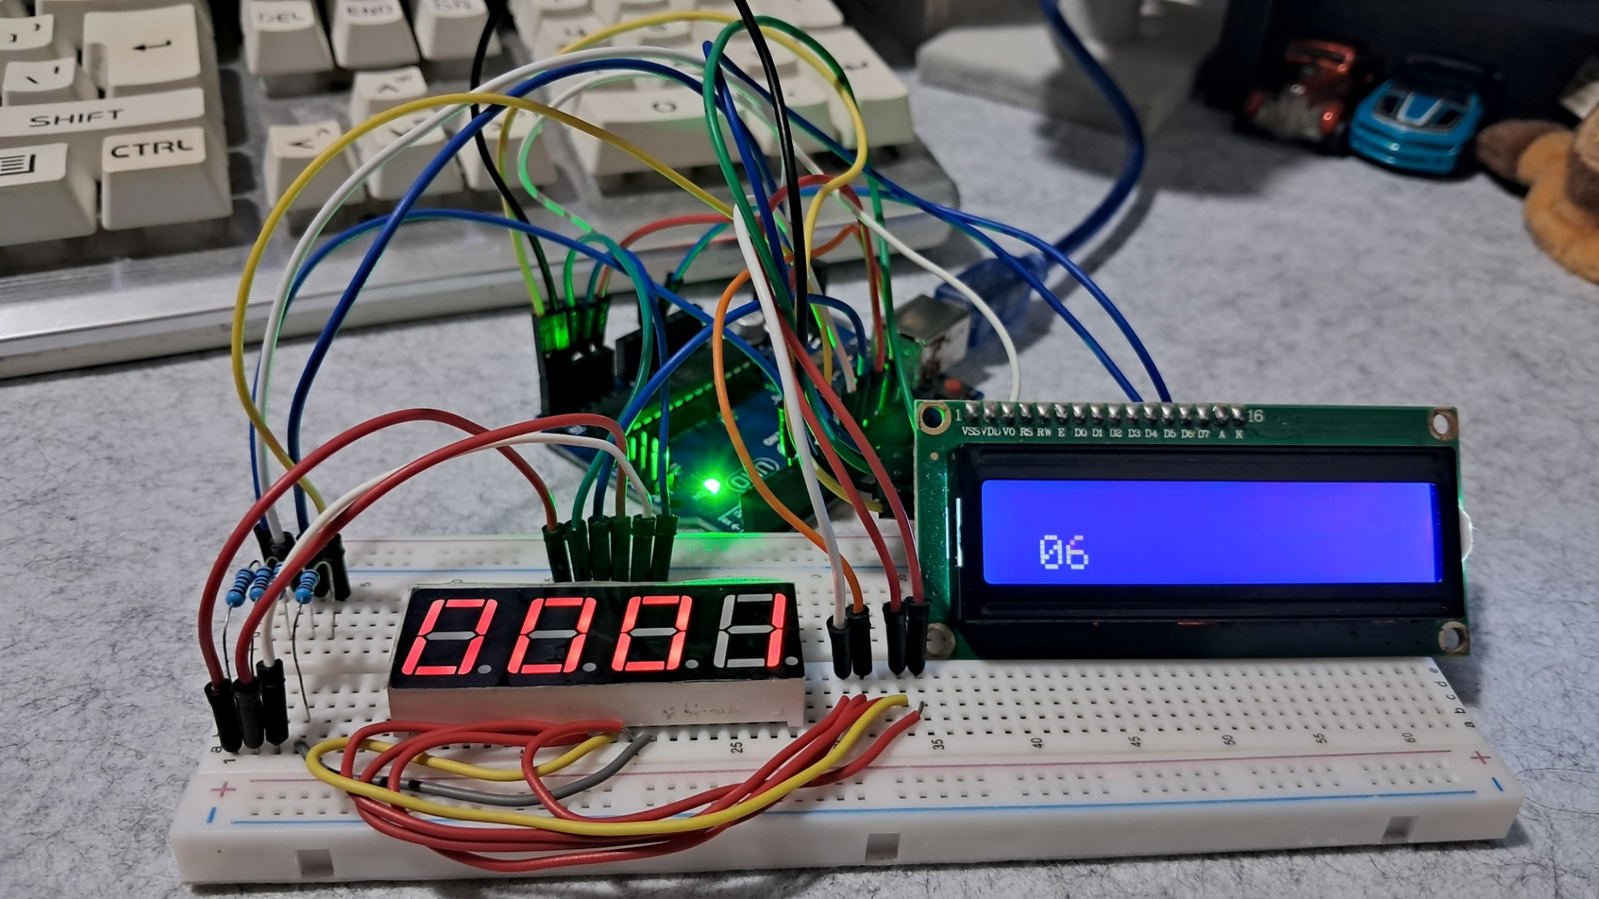
Final Output

Slide 12
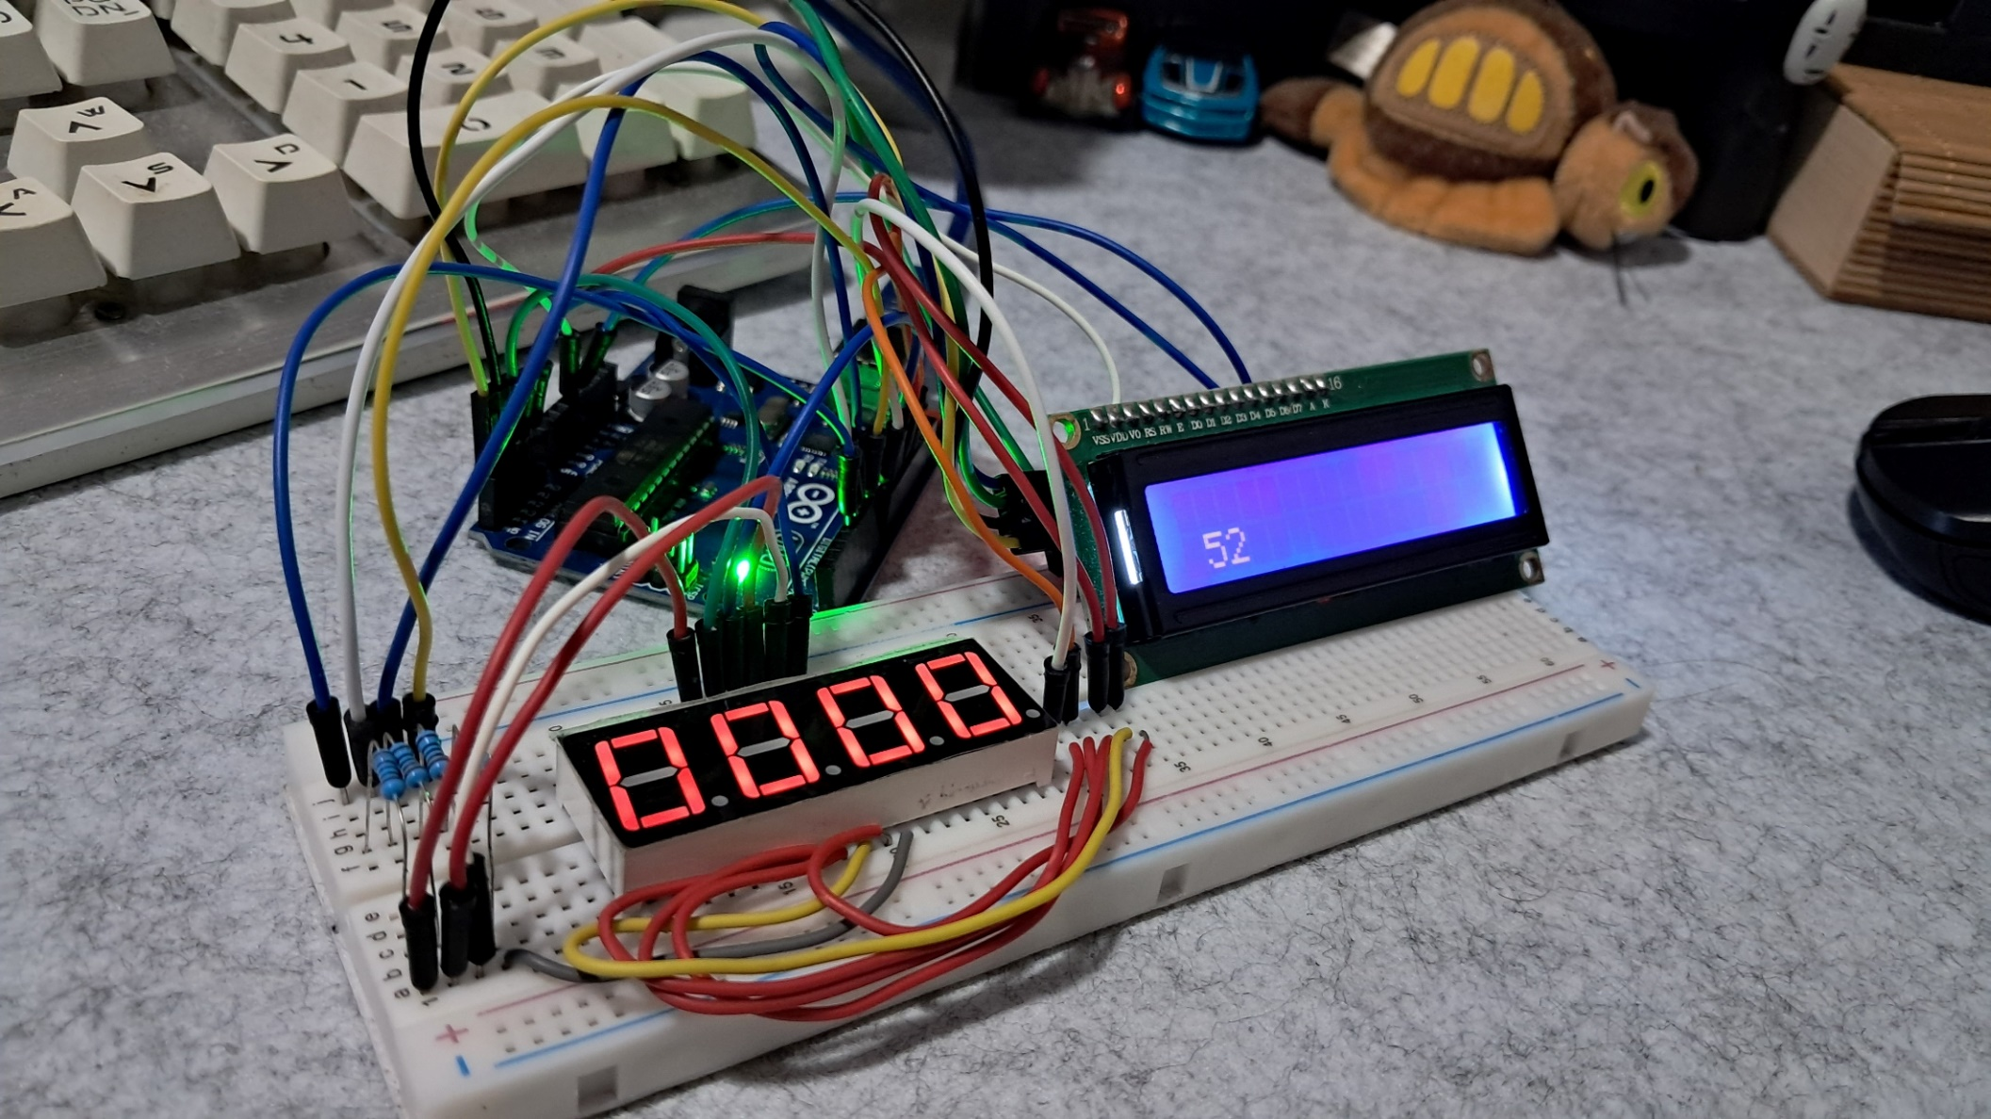
Final Output

Slide 13
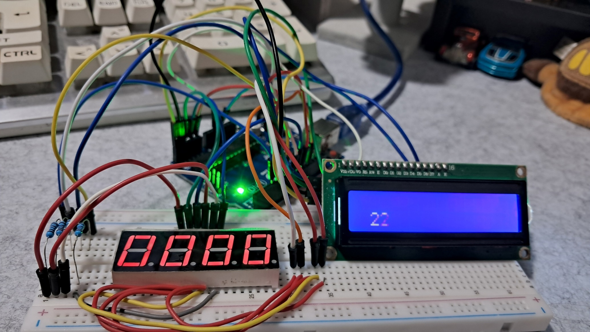
Final Output

Slide 14
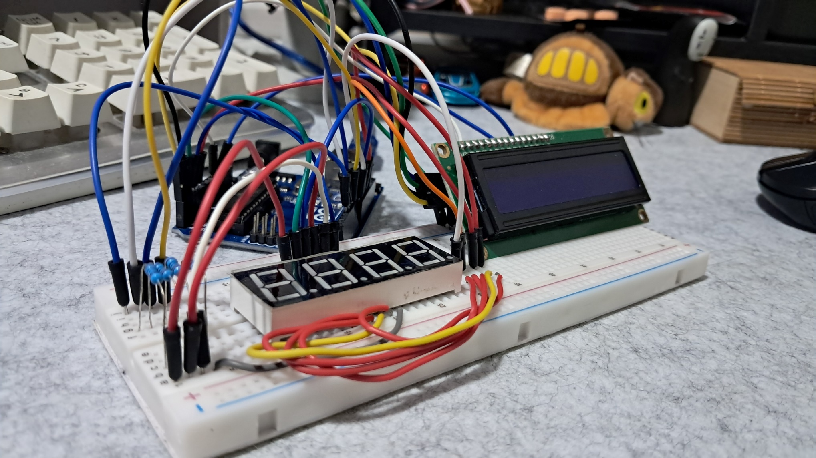
Final Output

Slide 15
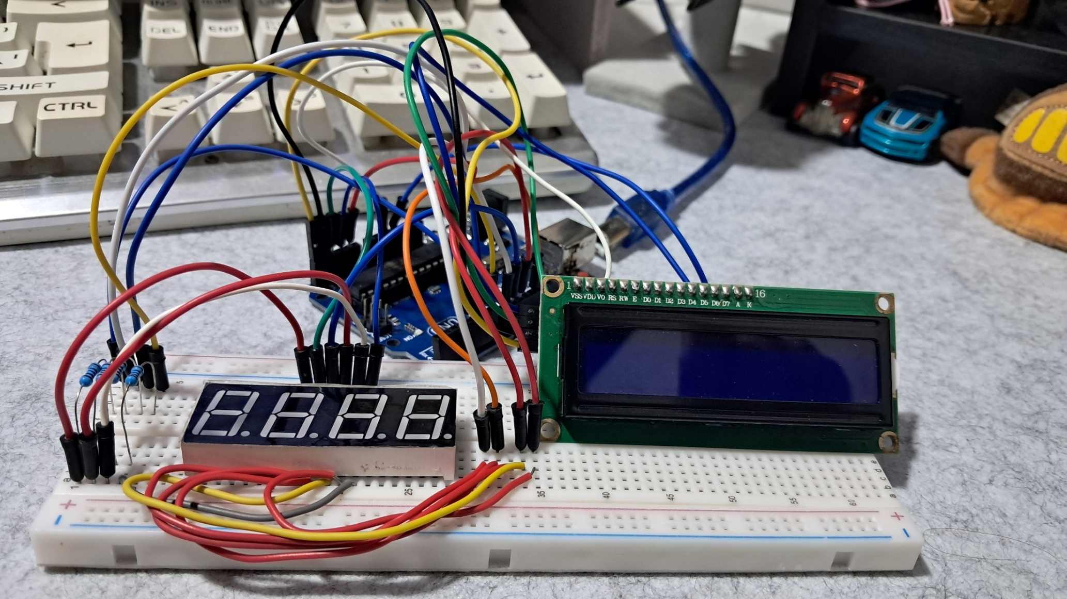
Final Output

Slide 16
THANK YOU!

